Slide 1
Best Practices for Library Publishing: the Library Publishing Toolkit
Allison Brown
Kate Pitcher SUNY Geneseo
Notes:
Presentation Abstract:
n 2012, several university libraries issued a research report entitled "Library Publishing Services: Strategies for Success", which outlines several important recommendations for how libraries can develop publishing services, specifically emphasizing the need for definition and development of best practices for these publishing strategies. Our presentation will introduce the audience to the Library Publishing Toolkit, a grant-funded project which is identifying, examining and curating opportunities for content creation and distribution in public and academic libraries. The presentation will report on project outcomes, including survey results and a preview of the forthcoming open access e-book. The Library Publishing Toolkit will serve as an essential guide and set of strategies for libraries of various types to get started or improve efficiency with publishing services. The Library Publishing Toolkit is sponsored by Rochester Regional Library Council (RRLC), 2013 Incubator funding and is a joint effort of SUNY Geneseo and the Monroe County Library System.
In this presentation, the audience will:
Learn about the Library Publishing Toolkit's purpose and goals.
Learn how they can contribute to the next edition of the Library Publishing Toolkit.
Take suggested use cases & strategies back to home institutions for conversation with colleagues about library publishing strategies & best practices

Slide 2
Background
Publishing services – what do we mean by [library] publishing?
2012 report, Library Publishing Services: Strategies for Success
Project funded and written by libraries at Purdue University, Georgia Institute of Technology and University of Utah
Notes:
I’ll begin our talk today by talking a bit about our landscape and the current environment in library publishing, but first…
What do we mean when we refer to [library] publishing? What does the phrase mean?
We do know that:
Creation and distribution of digital content presents a new field of opportunity for libraries of all types.
Libraries are morphing from keepers of content into content creators and curators, and are seeking best practices and efficient workflows with emerging publishing platforms and services.
Each type of library has unique users and content creators, but the process for creating and distributing the content has numerous new electronic publishing and print on demand services.
Papers, projects, theses, monographs and other data sets are produced every day within the academic environment, and many libraries have no methods or standards for capturing, publishing and distributing this content outside their campuses.
Public libraries, too, are creating and amassing digital content, but what other kinds of publishing and content creation and production are they being asked to support or standardize?
What are the new publishing models?
Before that, we need to understand the landscape, so I’m going to give you a summary of a research report released last year which will give you context for the evolution of the Library Publishing Toolkit and understanding for why we are involved in the project.
In 2010, three university libraries began to collaborate on a project to explore the future of publishing; specifically within academic libraries, but it could also be applicable to libraries outside the scope of academia. The three libraries involved: Purdue, Georgia Tech and Utah all had speciality domain knowledge within the library publishing world: Purdue in open access journals, Georgia in conference proceedings and Utah in monographs. Their project was to survey the current landscape of library publishing, building upon earlier work, and use the findings to build a case for new models.
Key findings include:
55% of respondents were interested in having, or have library publishing services of some format
Of the respondents with services, about half of them published conference proceedings, technical reports or monographs, mostly electronic, but some POD
Almost 90% of the library publishing programs were launched to contribute to change in the scholarly communication system
About half of the respondents with programs centralized management of publishing activities within one library unit, but the number of allocated staff was modest; staff dedicated soley to publishing were rare
Lack of sustainability planning for publishing services
OJS, Dspace & BePress were the most common platforms used
Three resources most needed for planning or operations were: guides to business issues, information on publishing platforms, and examples of policy & press documents

Slide 3
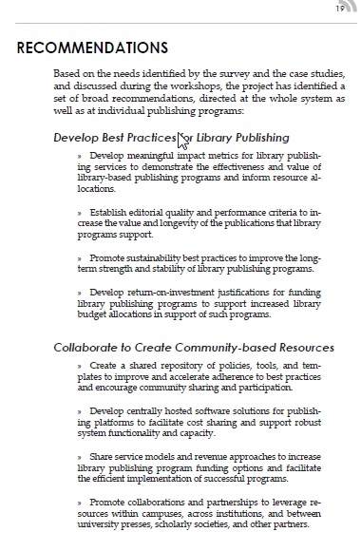
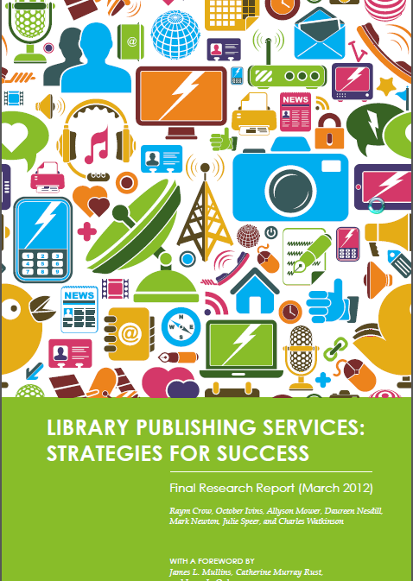
RECOMMENDATION #1: “develop best practices for library publishing”
RECOMMENDATION #2: “collaborate & create community resources for publishing”
Notes:
Based on these key findings and expressed needs indicated in the survey & case studies, the project identified and made three broad recommendations:
READ Recommendations document from report highlighted in yellow

Slide 4
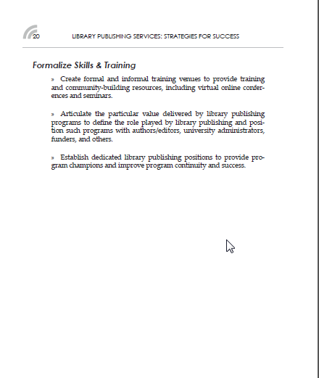
RECOMMENDATION #3: “formalize skills & training in publishing”
Notes:
READ Recommendations document from report highlighted in yellow
These recommendations, not just geared to individual research university libraries, but to the library publishing community as a whole.

Slide 5
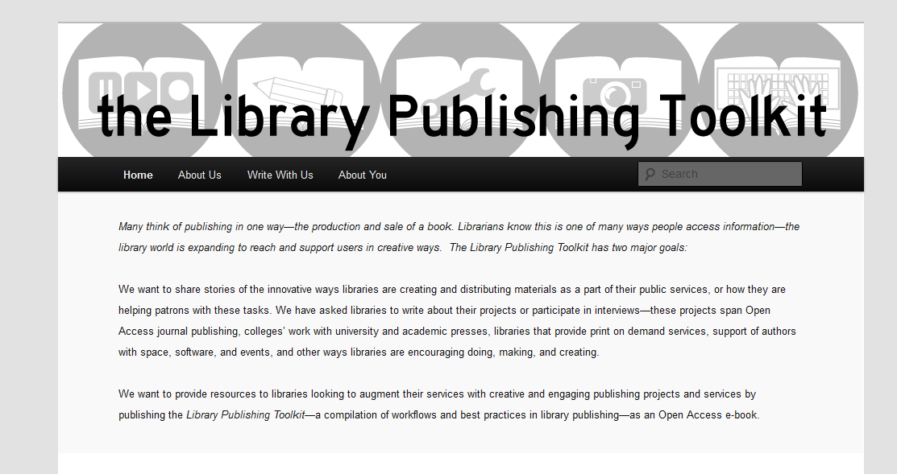
Library Publishing Toolkit
RRLC Incubator Project funding: $20,000 grant
Partnership with RRLC, MCLS, SUNY Geneseo
Public-academic library collaboration
Notes:
So, now I’ve given you some context about what the landscape of where the library publishing community is and what it is asking for.
This leads us into the purpose and the aims of the Library Publishing Toolkit, where a little background about its origins are in order…
In the summer of 2012, Mike Furlough, the Associate Dean for Research and Scholarly Communications at the Penn State University Libraries, was invited to give a day-long presentation at SUNY Geneseo on the topic of scholarly publishing and developing libraries as publishers.
Kathy Miller, the executive director of the local NY3Rs council (Rochester) attended and was enthusiastic about the possiblities of library publishing and was eager to work with SUNY Geneseo on further exploring how RRLC could help libraries with publishing.
One outcome of Mike Furlough’s talk was the organization of a “Libraries as Publishers” discussion group in the summer of 2012 for librarians in the Rochester region. The second outcome was the encouragement, by Kathy, of a collaboration between Geneseo and the Monroe County Library System (Rochester metro area libraries) and the development of a proposal to apply for incubator grant money to fund such a collaboration to explore new publishing models.
Several different ideas were floated, but it was decided, based on recommendations such as those found in the Library Strategies report, that development of best practices were crucial if library publishing efforts were to be successful. Cyril Oberlander and Patty Uttaro, the MCLS director wrote the grant together.
Thus, the idea behind the toolkit was for a practical and essential guide and set of strategies for local libraries of various types (in our first edition, just public and academic) to get started in publishing or improve their publishing efficiency.

Slide 6
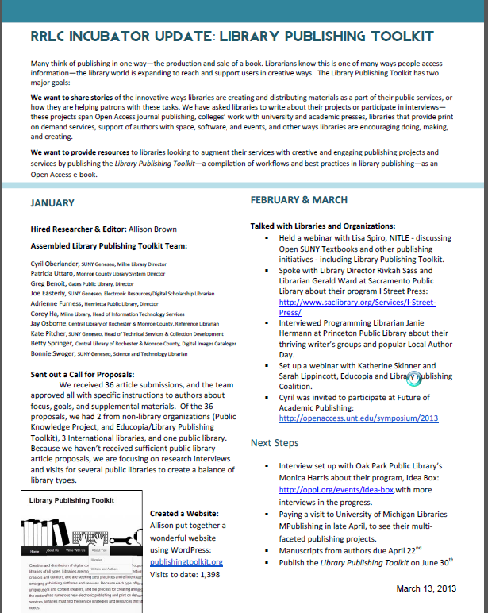
Project Scope:
Identify types of publishing services & content creation
Evaluation of services & software
Assess trends in publishing
Identify efficient workflows
Develop assessment and identify best practices
Notes:
So, project scope:
1. Develop strategies libraries can use to identify types of publishing services and content that can be created and curated by libraries.
2. Evaluate and recommend regional and web services, and software used for digital content creation and publishing.
3. Assess trends in digital content creation and publishing that can be useful in libraries and suggesting potential future projects. For example:
Storytelling - creates a communal, interactive experience (Pottermore is an example) and interacts with other media like books or tv; encourages “fan” writing – e.g. Fallen London and The Night Circus.
High interaction, multi-sensory engagement, content manipulation, open ended and educational - choose your own adventure type of interaction. ContoPlanet, Touchpress, ebooks as apps - this could be a way to publish interactive maps maybe in a project with RochesterSubway.
Short Form - short, single stories outside of collections.
Social Reading - GoodReads, Librarything, Amazon highlighting.
Start to finish publishing - writers are the new publishers. Vook, Lulu, Yudu, Issuu.
4. Identify efficient workflows for distributing content for free online and with potential for some cost-recovery in print-on-demand markets (Amazon, IBook, LuLu, etc.)
5. Develop assessment, and as editor of Library Publishing Toolkit contribute to best practices with a call to authors and contributors for publishing (with a Creative Commons License using Open Monograph Press) a “Best Practices” strategies for libraries of all types addressing the need for content creation and distribution.
With this in mind, the project will identify and examine the opportunities for content creation and distribution in public and academic libraries, help facilitate and develop the dialogue and presentations among the Libraries as Publishers Discussion Group at RRLC, and share the analysis and findings with libraries regionally and nationally. The Library Publishing Toolkit project will fund a position that will identify best practices in digital publishing, explore and test how they are applied to libraries, and recommend a process for developing, publishing, and distributing digital content. This position will serve as both a workflow consultant and as an editor of an open text Library Publishing Toolkit.

Slide 7
Project Outcomes
OUTPUTS/PRODUCTS:
Open ebook/POD, Library Publishing Toolkit (due: July 30th)
Papers submitted to various journals & trade publications
Presentations at RRLC & other venues
OUTCOMES:
Librarians will acquire a better understanding of digital publishing through
participation in the process
published best practices
Development of digital content standards which can be used in a consistent manner across libraries

Slide 8
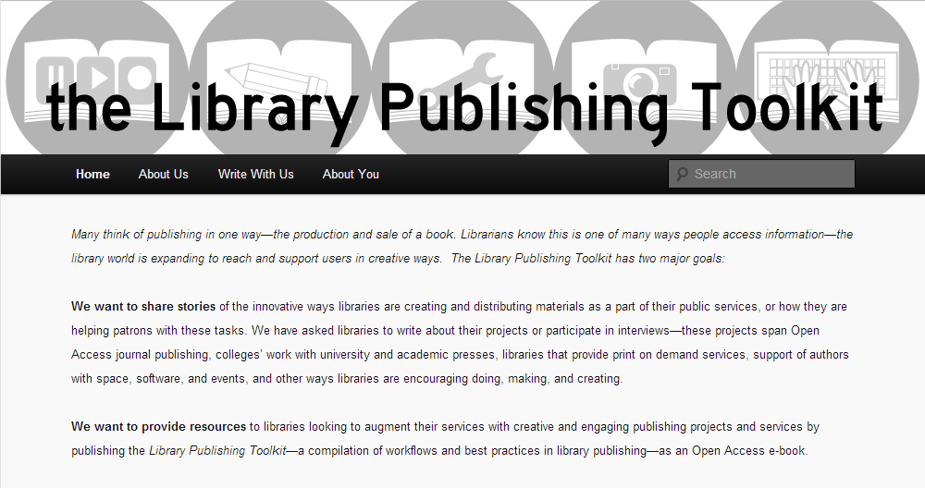
Notes:
My role: Talk to institutions, ask them to write & publish a book—print & open access ebook.
Strategy: Call for papers and direct requests for information, use Geneseo’s experience, my research to write about the library publishing landscape, present case studies, and compile resources. Outcome: 64 authors, 34 articles. Interviews with 12 public libraries and one company. Lots of examples from established publishing programs, case studies of pilot projects, and shared experiences and resources from both of these areas.
Today: Overview of library publishing –what is being published and how, and what are the roles and opportunities for libraries—both Academic and Public

Slide 9
Notes:
Breakdown of types of participants—give you an idea of both what to expect from the book and a good representation of what types of libraries are publishing/supporting publishing

Slide 10
What we’ve learned
or
Library Publishing as we see it
Notes:
What we see-what libraries can do/are doing.

Slide 11
CREATION
What is being published?
PRODUCTION
How is it packaged?
What tools are being used?
Who handles production?
ACCESS
How is it being distributed?
How is it being accessed?
How/where should it be marketed?
Elements of Library Publishing
Notes:
Helps to break down of areas of publishing to think about how libraries can support each area:
Creation—raw material—Niche, Local, short form
Production—administrative, editorial processes, and actual production
Access—how will the content be consumed (format) and found (discoverability, marketing)

Slide 12
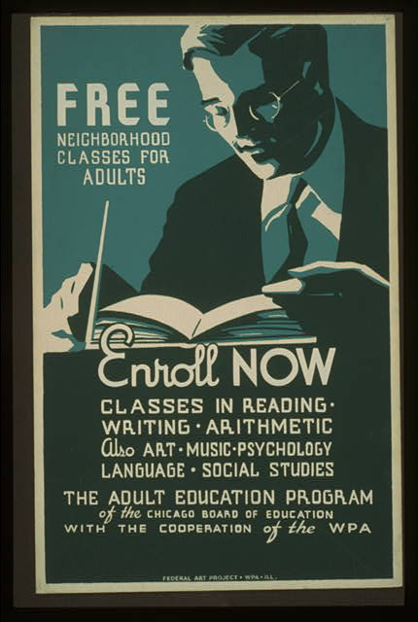
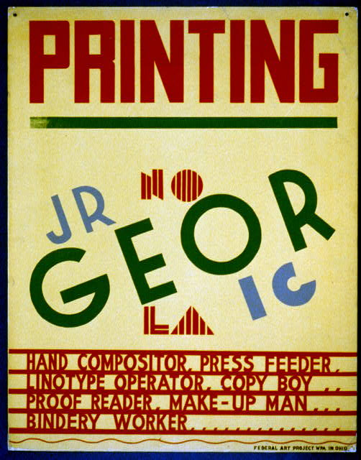
CREATION
PRODUCTION
ACCESS
Public Library Publishing
Images from: By the People, For the People: Posters from the WPA, 1936-1943, Prints & Photographs Division, Library of Congress
Notes:
Creation: Who are the creators, and what is the content of people that are looking to libraries or could be looking to libraries:
Who: Short answer—anyone in the community. Predominantly independent writers, self-pub.
What: Local interest, written by people in the community. Hyper local (family etc)
Niche, Local, Community-oriented
Written works
Fiction
Guides
Local Interest
Genealogies
Digital Creation
Audio/Video Production
Illustration/Design
Production: Since we’re mainly talking about independent writers (self-pub) Production tends to be straight forward—either print or e-books through online providers, distributors, POD. Some digital content (DMLS, infocommons) This step is mainly creator produced or outsourced
Print
MS Word, InDesign> PDF
POD (EBM, CreateSpace, Lulu, etc)
Electronic
eBook distributors (Smashwords, iBooks, Amazon)
Creator produced
Outsourced
Access: venues when it comes to libraries—
Local collections
Free online content
E-book lending systems
Library hosted marketing/ programming

Slide 13
CREATION
Provide examples of quality literature and media
Provide usable, flexible space to encourage creation and collaboration
Robust collection of resources
Foster a supportive community
PRODUCTION
Recommend standards
Writing
Design
Standard & high end software
Resources and guides
Accessible and helpful staff
ACCESS
Acquisitions of independently published books & ebooks
Policies
3rd party ebook lenders
Homegrown ebook lending systems
Marketing & providing space for marketing
Public Library Publishing
Roles & Opportunities
Notes:
How are libraries involved in this process?
Creation: We are already involved in and supporting creation—though we could be more: examples, programs—providing space as a networking hub.
Production: Creator produced—but this could be library supported. Specific programming—recommending standards and resources for editing and production, supporting the software needed.
Access: Libraries can play a huge role. The first is just getting these books into collections—not as simple as it sounds. Many libraries don’t have policies about acquiring self-published books (case by case). Commercial ebook lenders are just starting to offer titles from sites such as Smashwords. Also just now seeing locally hosted homegrown ebook lending systems in the Douglas County Model.

Slide 14
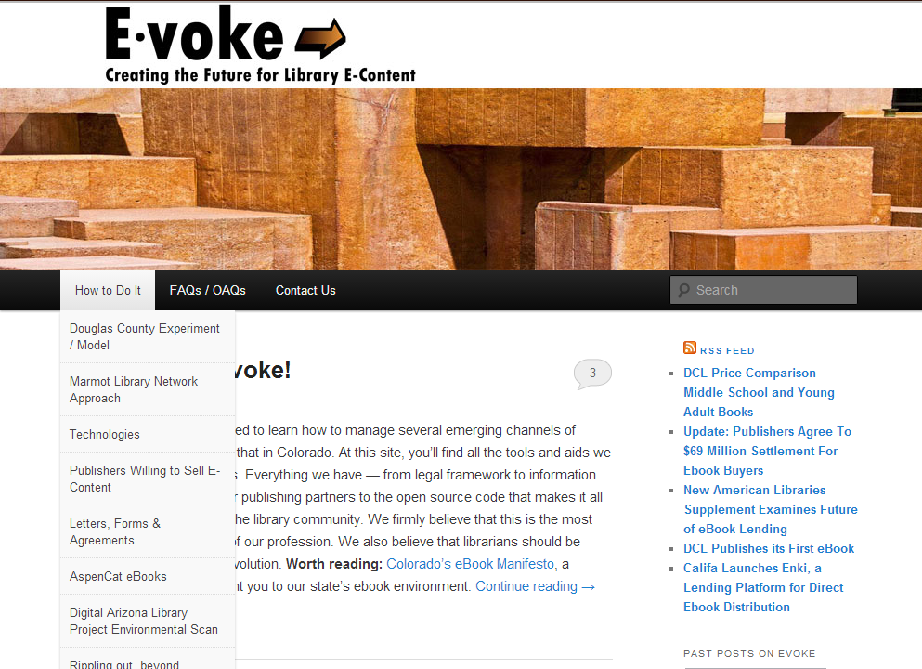
Notes:
If you’re not familiar, the Douglas County Libraries piloted a project that led the development of an open access discovery layer for their catalog—they implemented this with a Adobe content server they purchased, which allowed them to directly acquire e-content from willing publishers. No licensing, no per-transaction fee or yearly fee, they paid for the content, they own it, host it, and manage it.
This is big in the PL world, and when I go over the TOC I’ll talk a little more about what DCL are doing to support the creation as well as access of materials.

Slide 15
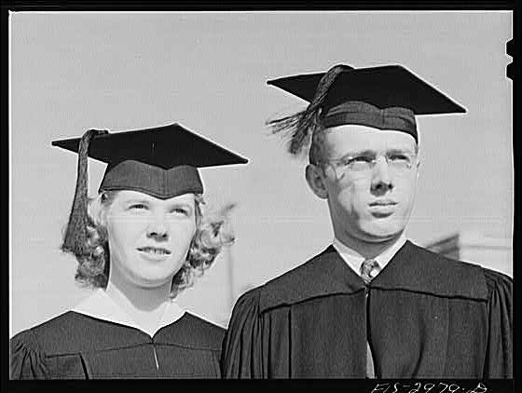
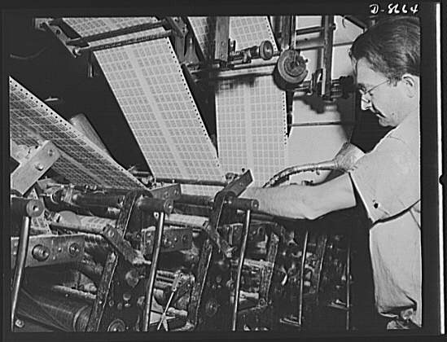
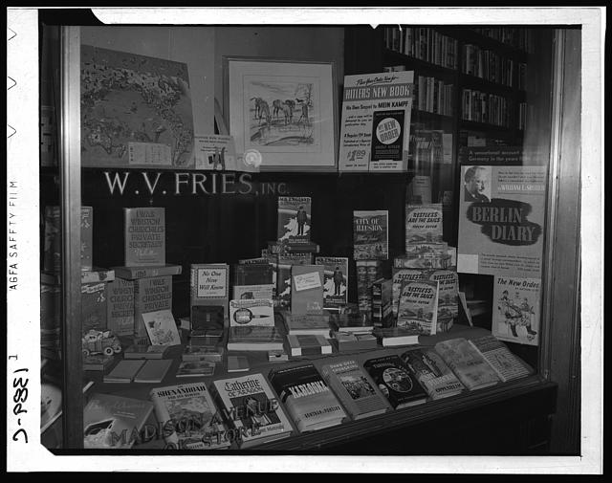
CREATION
PRODUCTION
ACCESS
Academic Library Publishing
Images from: America from the Great Depression to World War II: Black-and-White Photographs from the FSA-OWI, 1935-1945
Notes:
Lets take a look at Academic Publishing in terms of libraries
Creation: Similar to PL—local content produced by our faculty and students. Local collection, archival material we house
Faculty-written publications
Faculty-edited publications
Student research
Student creative work
Archival materials
Local interest/history
Production: There’s more diversity here in terms of formats, platforms and tools—predominantly monographs, or journals online/print or both. More diversity in terms of who handles it—more cases of the library handling actual typesetting and design, but still cases where the library is hosting and supporting the platform
Print
MS Word, InDesign> PDF
Electronic
WordPress, OJS, OMP, Digital Commons, Dspace
Both
XML Markup & automated workflows
Library produced
Creator produced/Library Supported
Outsourced
Access: Similarly sticky—in terms of academic content, its not an issue of how to get it, its an issue of how to allow your readers to find it because there are so many databases, etc.
Local Collection
Indexing services
Databases
Directories
DOAJ
Vendors

Slide 16
CREATION
Provide research materials
Provide publishing education/consulting
Curate materials & collection
PRODUCTION
Recommend & reflect standards
OA education
Code of Conduct
Develop & recommend workflow
Platforms & technical infrastructure
ACCESS
Provide standard object identifiers (DOI, ISSN, ISBN)
Preparing & entering metadata
Academic Library Publishing
Roles & Opportunities
Notes:
What are academic libraries doing in publishing?
Creation: A role we already play
Production: Being knowledgeable about standards and communicating those standards. We are already advocates of open access, so we should be advocates of really well-run open access publications. Workflow & infrastructure—important for consistency and sustainability.
Access: Another place we can recommend and uphold standards, like DOIs ISSN etc, and increase discoverability

Slide 17
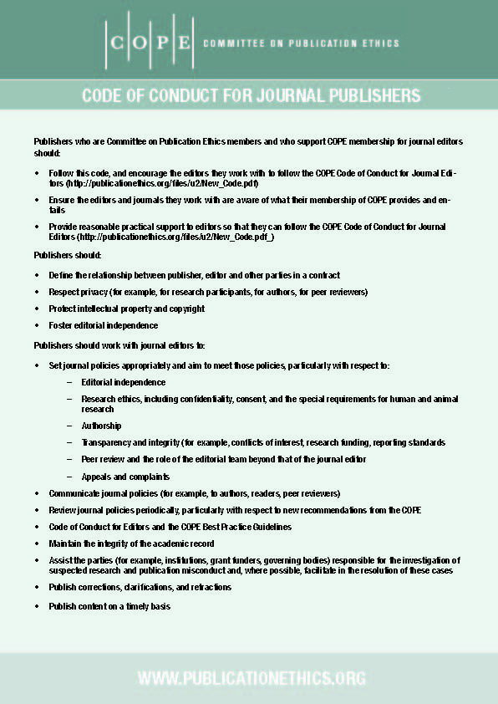
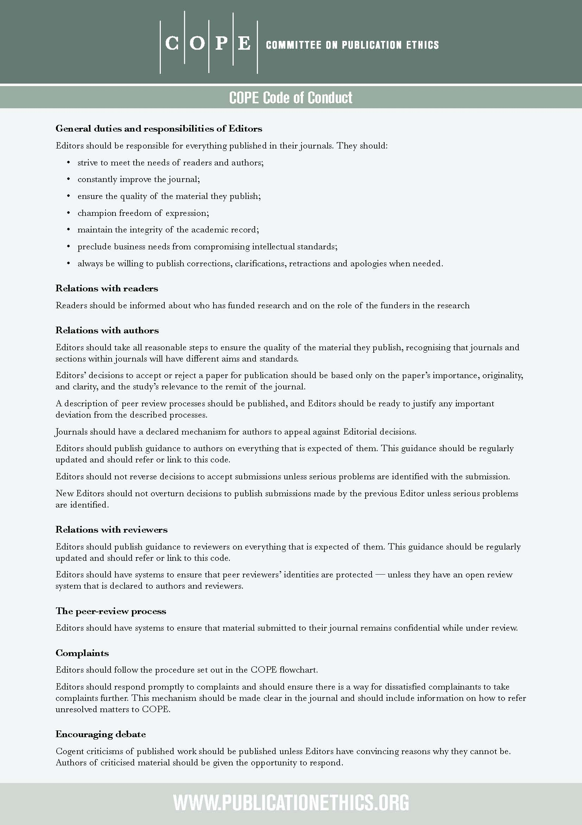
Notes:
Here are a couple examples of what I mean:
Example of the code of conduct from the committee on publication ethics

Slide 18
From “How to Succeed at Launching an OA Journal” by Nick Paulus
Graphic by Nick Paulus

Slide 19
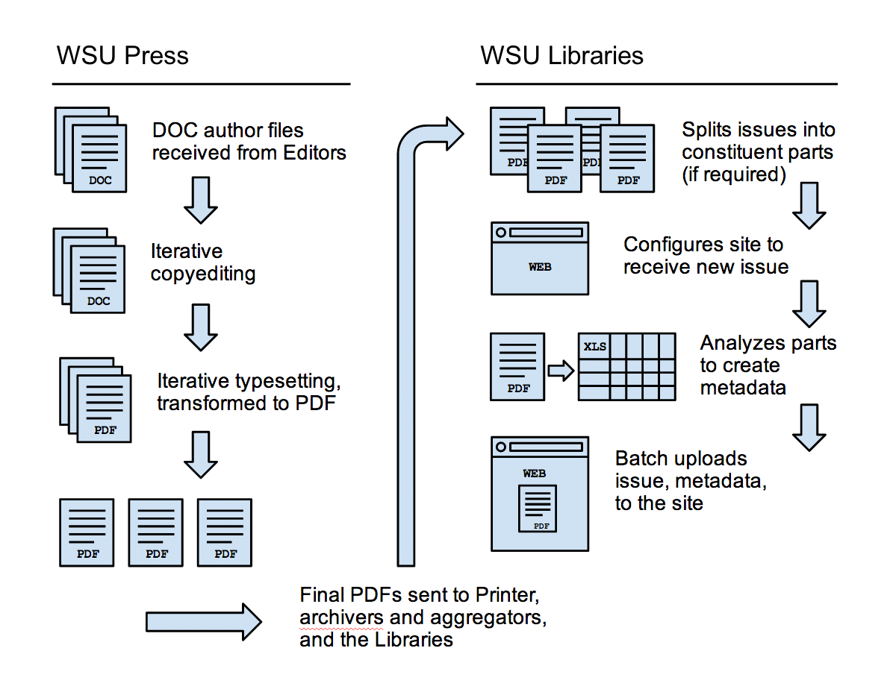
From “Wayne State University Press and Libraries: A Case Study of a Library and University Press Journal Publishing Partnership” by Joshua Neds-Fox, Lauren Crocker, and Alicia Vonderharr
archivists
Notes:
Workflow of how a Press & Library work together to create a publication

Slide 20
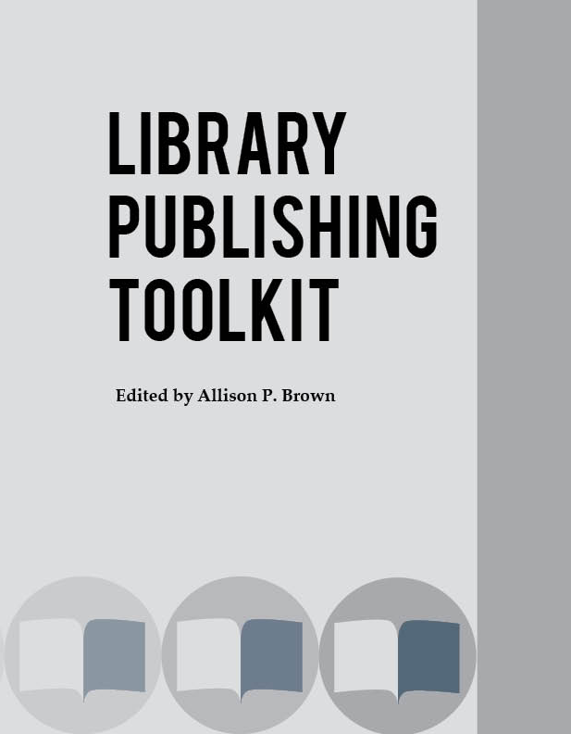

Slide 21
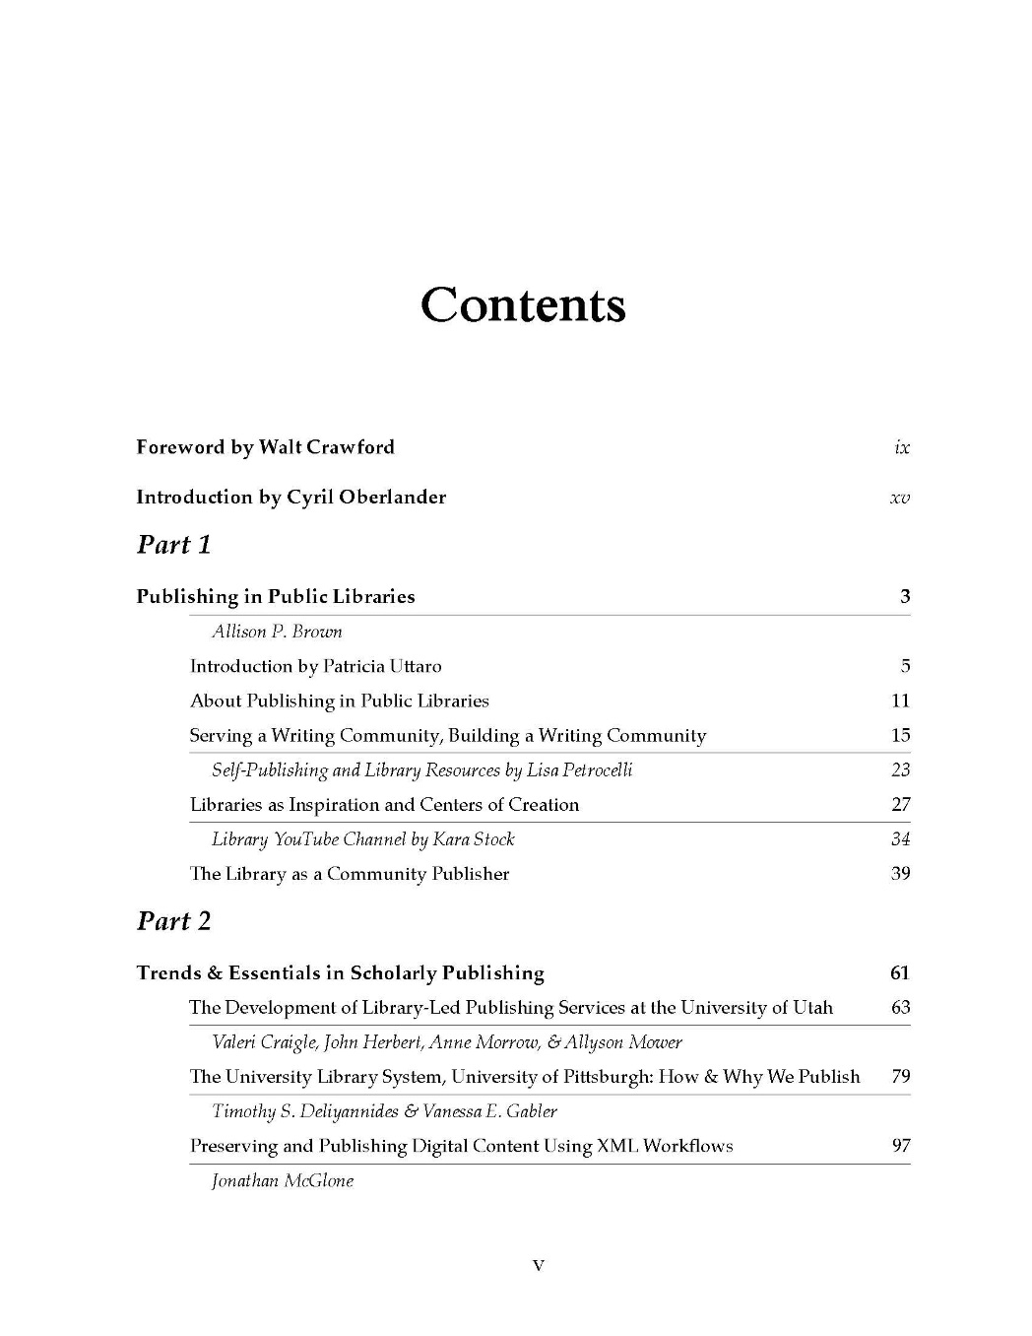
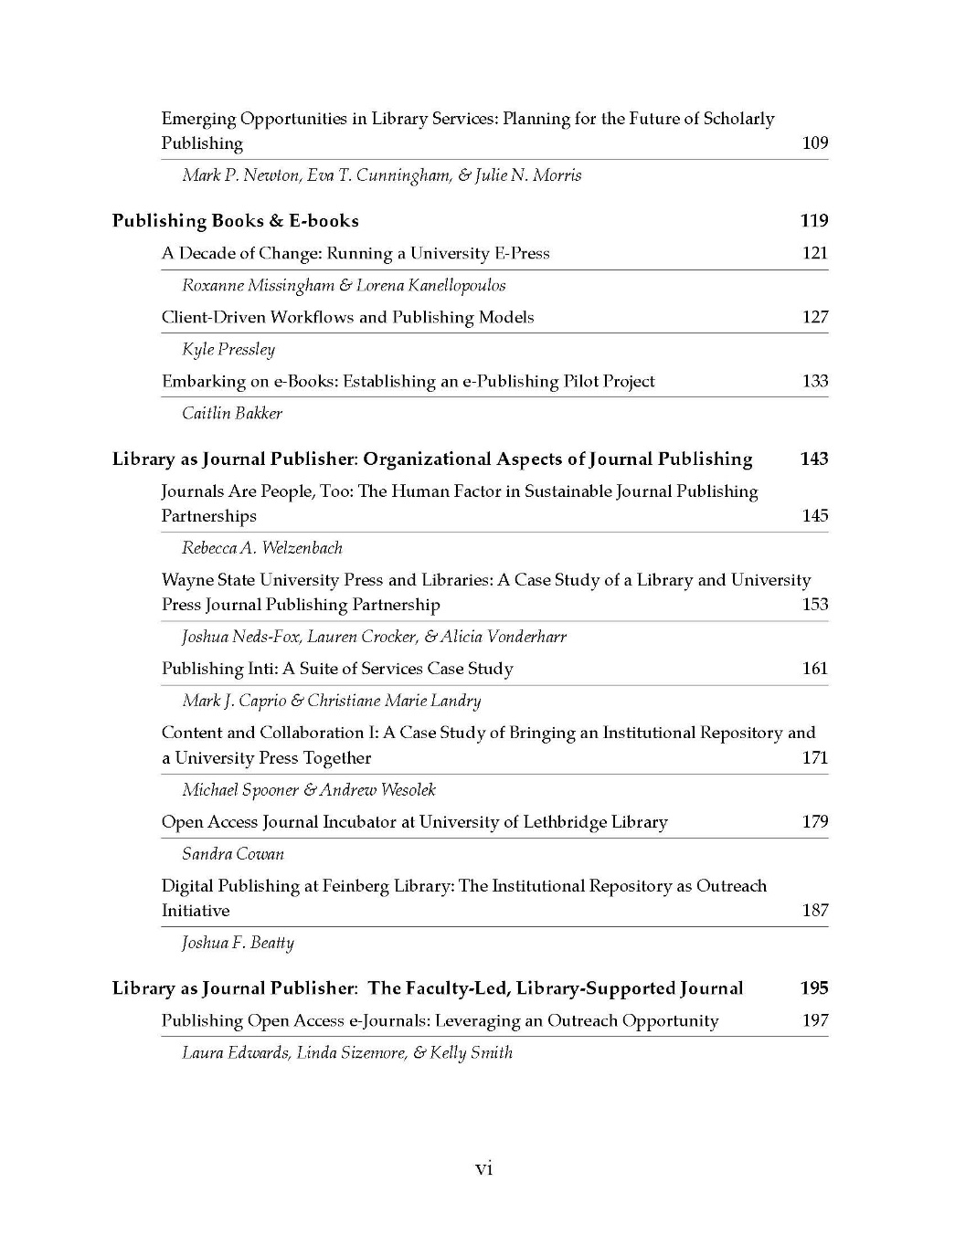

Slide 22
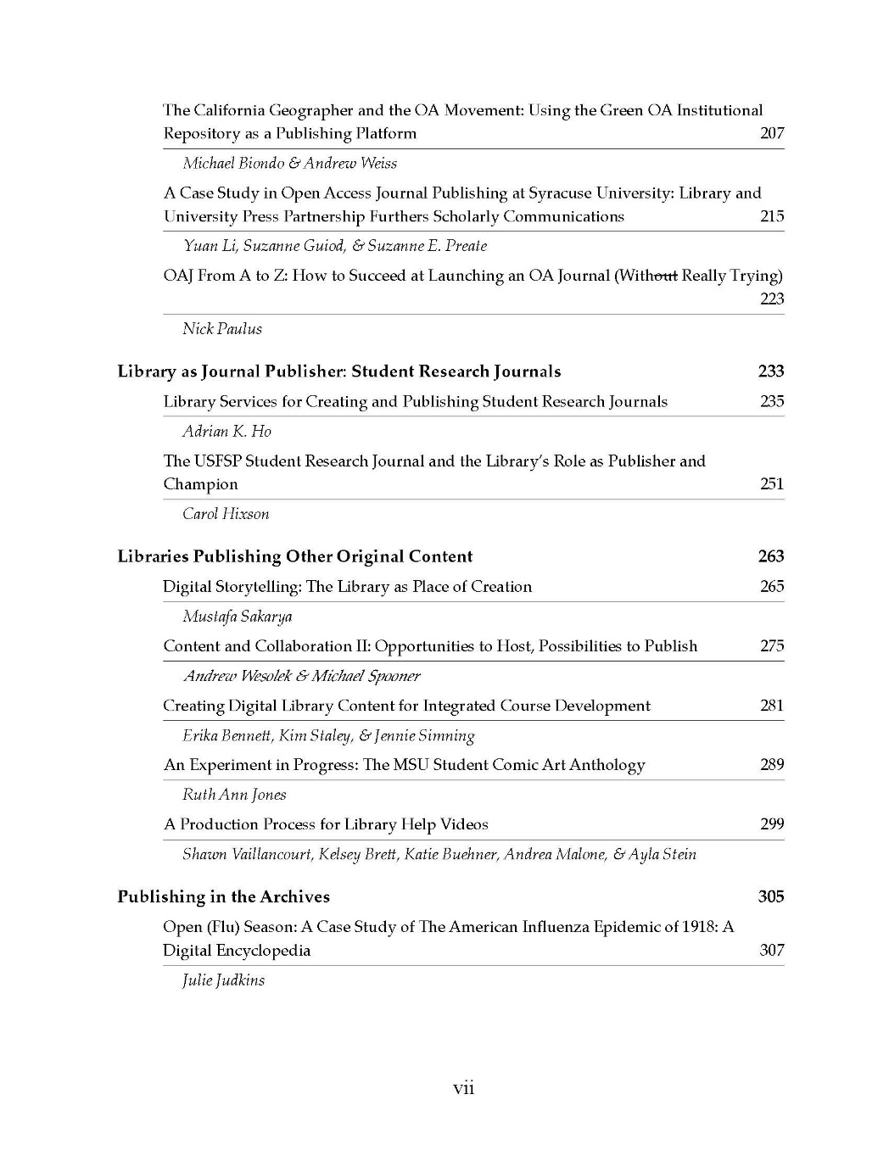
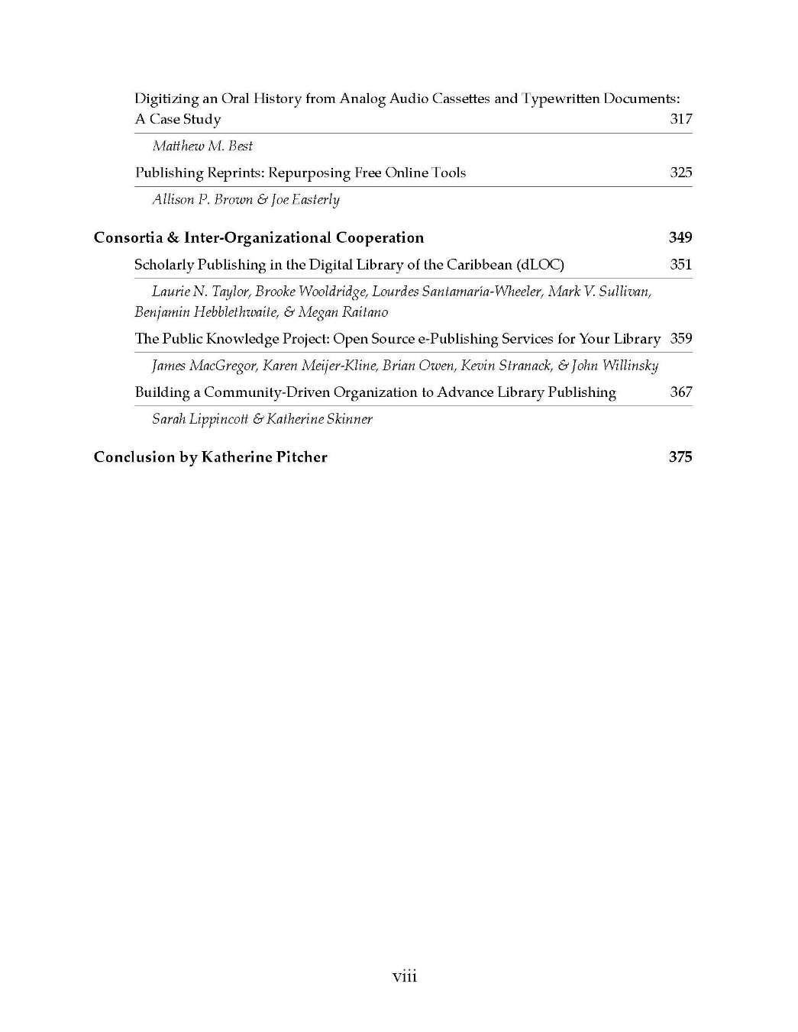

Slide 23
Topics & Case Studies in the toolkit
Notes:
Overview/Preview

Slide 24
TRENDS IN PUBLISHING IN PUBLIC LIBRARIES

Slide 25
AUTHOR SERVICES
Theme | Library/Author
Hosting Writer’s Groups & Local Author Celebration | Princeton Public Library, NJ
Fostering Writer’s Groups & Planning Programming for Writers | Safety Harbor Public Library, FL & Wirt Public Library, MI
Author Incubator Program | Douglas County Libraries, CO
Self-Publisher Perspective | Lisa Petrocelli, NY
Notes:
Case studies of libraries supporting writers and authors--DCL

Slide 26
LIBRARY AS INSPIRATION & CENTER OF CREATION
Idea Box: the Power of Space | Idea Box, Oak Park Public Library, IL
Supporting Digital Creation & Knowledge Sharing | LibraryYOU Escondido Public Library, CA
Creation & Publishing of Patron Resources | Kara Stock, Buffalo & Erie County Public Library, NY
A Creation-Centered Redesign | Patrica Uttaro, Monroe County Library Systems, NY
Notes:
Libraries supporting digital media creation, and the general encouragement of creation and making

Slide 27
LIBRARY AS MICRO-PUBLISHER
Neighborhood Publisher: the Espresso Book Machine & Community Impact | I Street Press, Sacramento Public Library
EBM: Use Cases | Brooklyn Public Library & Flashbooks! Riverside County Library System
Library as eBook Publisher | Provincetown Public Press
Library Co-branded Self-Publishing | Los Gatos Public Library & Smashwords
Notes:
Library acting as a community/micro-publisher. In cases of libraries using the EBM, the library has the opportunity to link print on demand services with other author services, be a local resource for authors and community organizations that would otherwise be using an online service disconnected from where they are writing.

Slide 28
Trends & essentials in Scholarly Publishing

Slide 29
Trends & Best Practices in Scholarly Publishing
TOPIC | INSTITUTION | ARTICLE TITLE
Assessment | University of Utah | The Development of Library-led Publishing Services at the University of Utah
Marketing | University of Michigan | Marketing & Outreach for Campus-Based Publishing Services: A Lightweight Approach
Production streamlining--XML workflows | University of Michigan | Preserving and Publishing Digital Content Using XML Workflows
E-Journal Publishing | University of Pittsburgh | The University Library System, University of Pittsburgh: How and why we publish
Service Models | Columbia University | Emerging Opportunities in Library Services: Planning for the future of Scholarly Publishing
Notes:
Opening section deals with general topics that are widely applicable. It also features a few established and larger publishing services to showcase different methods, services and workflows.

Slide 30
PUBLISHING BOOKS & EBOOKS
Library and University Press partnership | Australian National University | A Decade of Change: Running a University e-Press
Service models in POD publishing | Michigan State University | Client-driven Workflows and Publishing Models
Establishing e-Publishing Workflows | University of Northern British Columbia | Embarking on e-Books: Establishing an e-Publishing Pilot Project
Notes:
The next section features articles that talk about publishing monographs—both in print and electronically.

Slide 31
Journal Publishing
Set-up and Organizational Structure
Notes:
Journal publishing is obviously the largest section since it’s the most common need on campuses

Slide 32
Journal Publishing
Library and University Press Partnerships | Wayne State University | Case Study: Library and University Press as Journal Publishing Partners
Establishment of Digital Publishing Services | Providence College | Publishing Inti: A Suite of Services Case Study
Merging a University Press with an Institutional Repository | Utah State University | Content and Collaboration: Bringing an Institutional Repository and a University Press Together
Establishment of a Journal Incubator Program | University of Lethbridge | Open Access Journal Incubator at the University of Lethbridge Library
Sustainability | University of Michigan | Journals are People Too!: Human Motivations and Priorities as Indicators of Serial Success and Sustainability
Institutional Repositories | SUNY Plattsburgh | Digital Publishing at Feinberg Library: The Institutional Repository as Outreach Initiative
Notes:
Addresses organizational aspects of supporting journals, and a few instances of a press and a library merging.

Slide 33
The Faculty-Led, Library-Supported Journal
JOURNAL PUBLISHING
Relationship Building | Eastern Kentucky University | Hosting Open Access eJournals: Challenges, Opportunities, and Rewards
Service model and platform implementation | Syracuse University | A Case Study in Open Access Journal Publishing at Syracuse University: Partnership between University Press and Libraries furthers Scholarly Communications
Roles & Responsibilities in Library-Supported Journals | Rochester Institute of Technology | Strategies and workflows for launching new open access journal
Transitioning from Traditional Publishing to Open Access | California State University, Northridge | The California Geographer and the OA Movement: Using the Green OA Institutional Repository as publishing platform
Notes:
Then more specifically we have articles that talk about the library as host and supporter to a publication that is largely faculty led and edited

Slide 34
Student Research Journals
JOURNAL PUBLISHING
Workflow & Marketing | University of South Florida St. Petersburg | USFSP Student Research Journal and the Library’s Role as Publisher and Champion
Roles & Expectations | University of Kentucky | A Library’s Services for Creating and Hosting Student-Run Research Journals
Notes:
A lot of institutions are looking at ways to feature or promote publishing in the undergrad realm. These are a couple case studies of the establishment of student research journals.

Slide 35
PUBLISHING ORIGINAL WORK
Digital Storytelling | Mercy College | Digital storytelling: library as place of creation
Dynamic Publishing Platforms | Utah State University | Content and Collaboration: Bringing an Institutional Repository and a University Press Together II
Publishing Student Work | Michigan State University | The MSU Student Comic Art Anthology
Workflow of Producing a Patron Service | University of Houston | A production process for Library Help Videos
Faculty Collaboration | Capella University | Creating Digital Library Content for Integrated Course Development
Writing & Communication | SUNY Maritime College | From Ship to Shore: A Case Study of Blogging at the Stephen B. Luce Library
Notes:
Our most diverse section is publishing original work because these projects are all over the map.

Slide 36
PUBLISHING IN THE ARCHIVES
Digital Encyclopedia | University of Michigan Medical School | American Influenza Epidemic of 1918: A Digital Encyclopedia (AIE)
Selection & Publication of Audio Archives | Erie Community College | Digitizing an Oral History from Analog Audio Cassettes and Typewritten Documents: A Case Study
Notes:
Instances of publishing content from the archives.

Slide 37
CAMPUS COLLABORATION
Relationship Building | Eastern Kentucky University | Hosting Open Access eJournals: Challenges, Opportunities, and Rewards
Faculty Collaboration | Capella University | Creating Digital Library Content for Integrated Course Development
Communication | SUNY Maritime College | From Ship to Shore: A Case Study of Blogging at the Stephen B. Luce Library

Slide 38
CONSORTIA & INTER- ORGANIZATIONAL COOPERATION
Cooperative Approach | University of Florida and Florida International University | Scholarly Publishing in the Digital Library of the Caribbean (dLOC)
Formal Consortia | Library Publishing Coalition | Library Publishing Coalition: Building a Community-Driven Organization to Advance Library Publishing
Cooperatively Developed Workflow & Infrastructure | Simon Fraser University | The Public Knowledge Project: Open Source ePublishing Services for your Library
Notes:
Lastly, we have examples of multiple institutions working together to either publish or offer publishing services and infrastructure.

Slide 39
Key elements in successful library publishing programs…
Public Libraries
Academic Libraries
Branding & marketing of services
Understanding their authors (developing integral author services)
Development of community partnerships
Assessment
Infrastructure for new and ongoing publications
MOUs and service-level agreements
Established timelines
Notes:
These are a few key points and commonalities we saw in these case studies.
PL: unify the services with branding & marketing, knowing the community/authors, working with existing orgs.
AL: know what the community needs/what the library can handle. Setting up infrastructure first! Establishing service agreements so publishing partners know what they can expect of you and what you expect of them. Timelines—internal and publication oriented.
That’s the overview—the libraries and authors listed here have been really generous with sharing their methods, and a lot of times the tools they use. So the book will have embedded resources like sample assessment scoring models, software and platform reviews and comparisons, even some templates.
The book is on schedule to come out in July—we had hoped for June but we wanted to make sure we had plenty of time for editing. Available in print through Amazon, as well as a free ebook through IDS Project Press on Open Monograph Press, and a lot of the recommended resources from the authors or from our research will be posted on our website—as well as downloadable material that can’t be included in the book

Slide 40
Marketing Plan for LPT
Advertise
Reviewers’ copies
Press release
Amazon sales channel (POD)
OMP (free online)
MARC record
distributed via XML on LPT website
OCLC record via WorldCat
Notes:
Kate

Slide 41
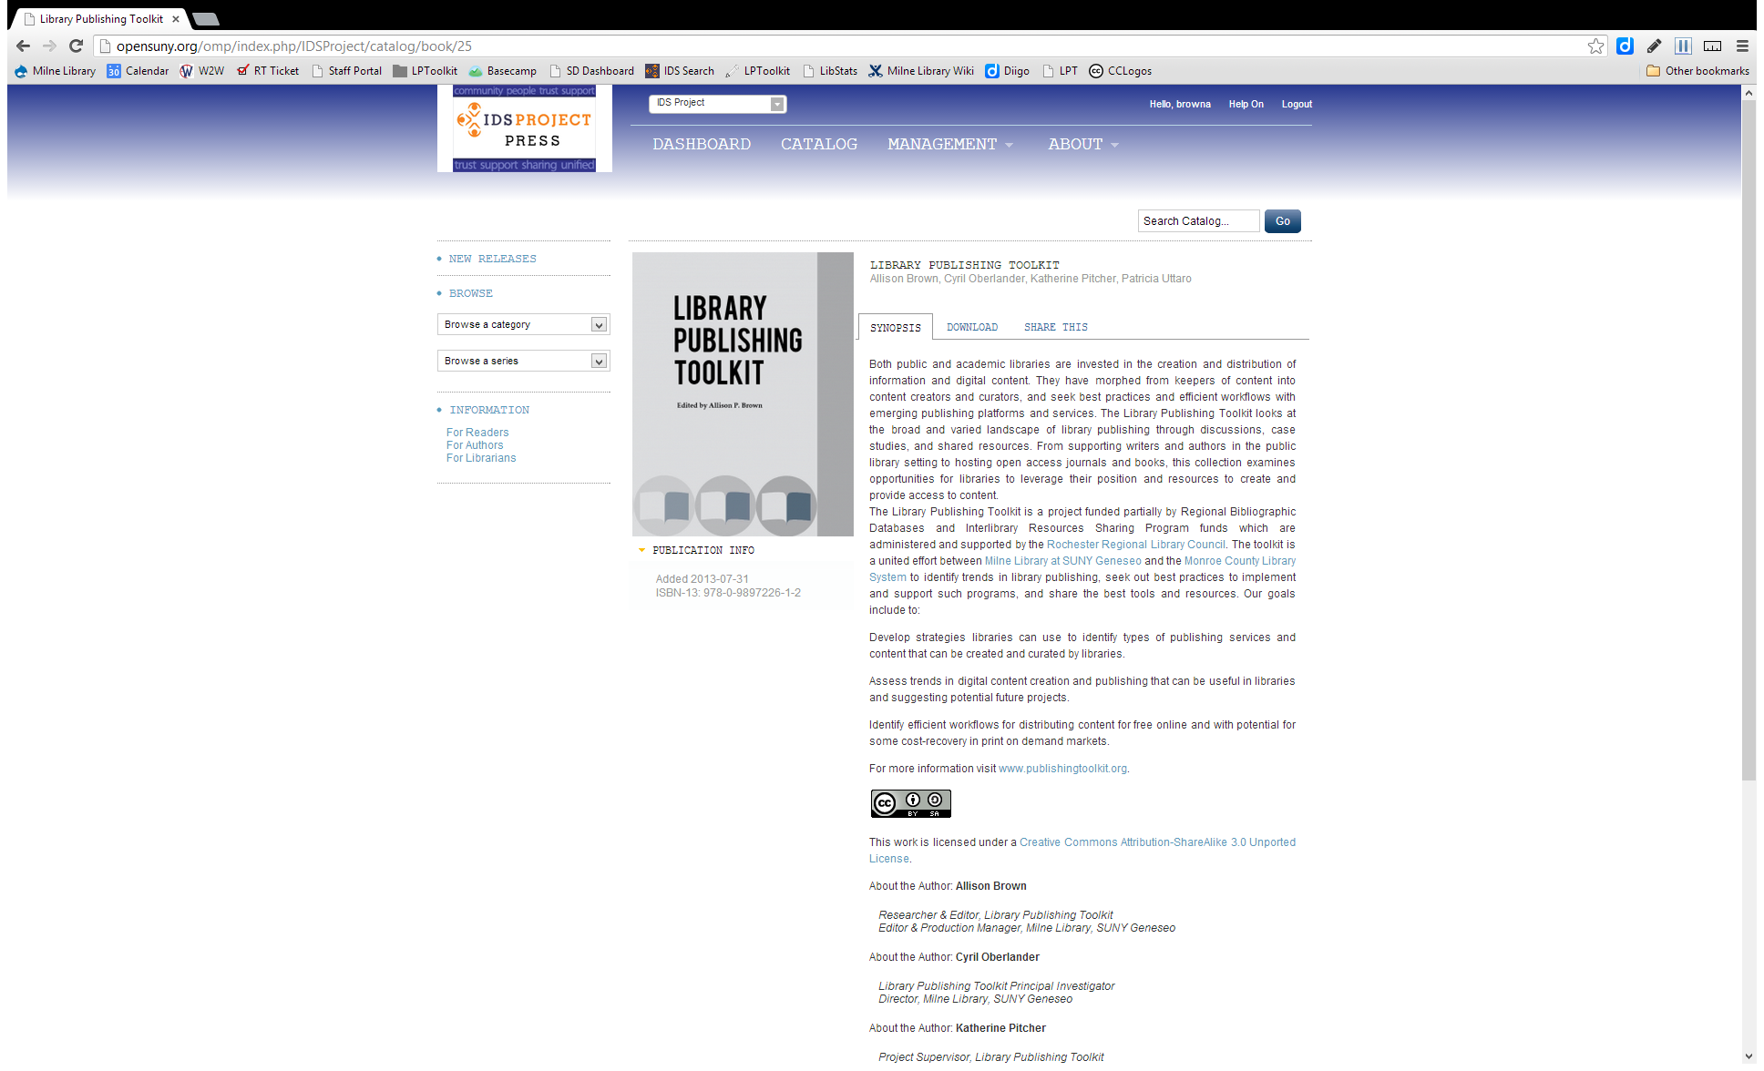

Slide 42
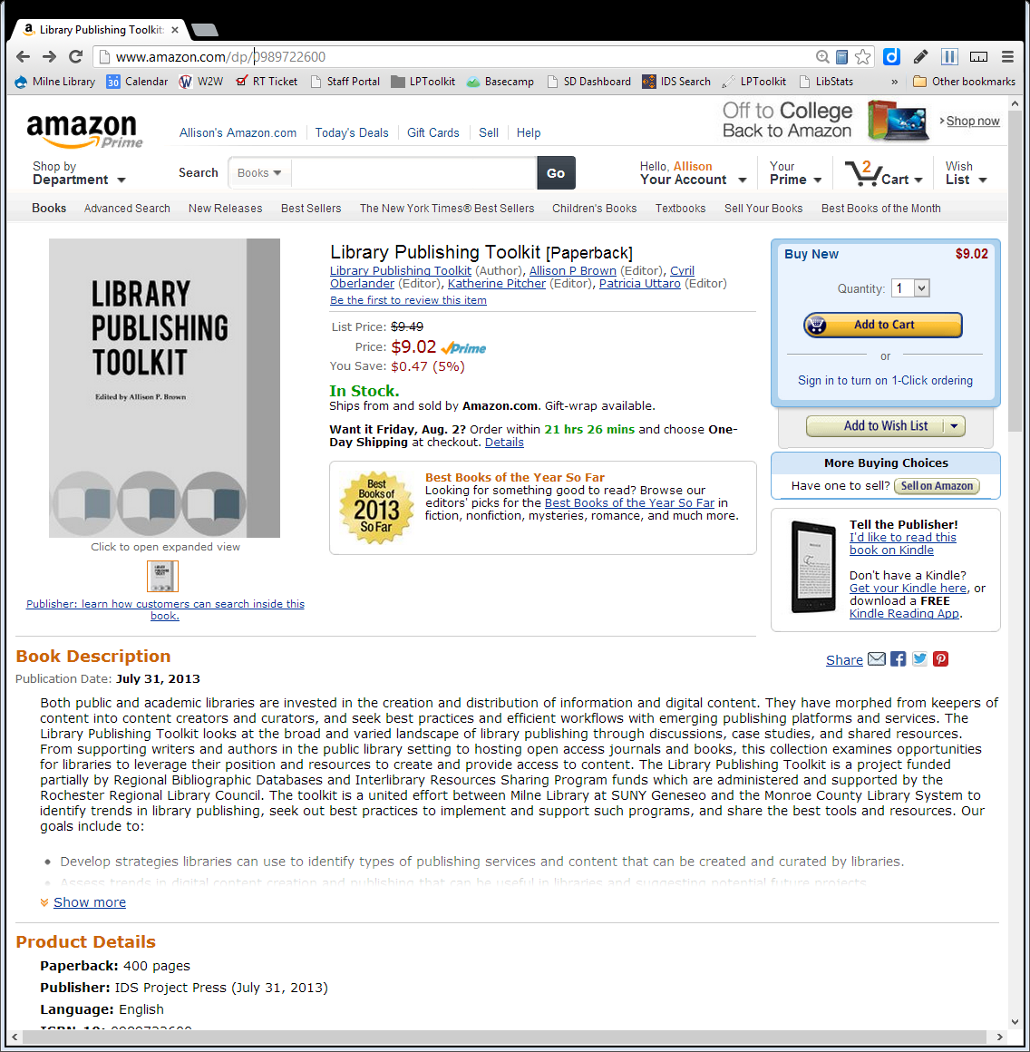

Slide 43
Future of library publishing & toolkit
Do you have questions, comments, or stories about publishing or your library’s involvement in publishing?
What role would you like your library to play in publishing?
What kinds of resources, best practices, or documentation do you need?
Notes:
Kate
What would you like to see in Version 2 of the Toolkit?

Slide 44
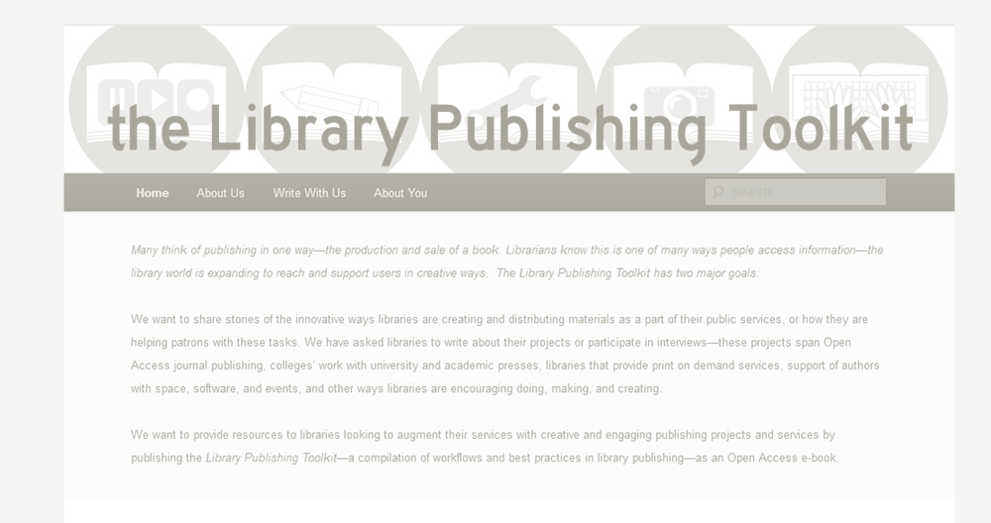
Contact information
http://publishingtoolkit.org
Allison Brown
Kate Pitcher
SUNY Geneseo
LPT Researcher/Editor
browna@geneseo.edu
SUNY Geneseo
Head, Technical Services
pitcher@geneseo.edu

